Slide 1
Transshipment Project
~ GROUP 8 ~
Tianxiao Yu
Qinhao Chang
Shaoqian Chen
Wei Li

Slide 2
Introduction
Transshipment is the shipment of goods or containers to an intermediate destination, and then from there to yet another destination.
Possible reason:
Change the means of transport (transloading)
Combine small shipments into a large shipment (consolidation)
Divide the large shipment at the other end (deconsolidation)

Slide 3
Model - Assumption
Assume that initial inventory level is known.
Replenishments arrive (based on orders placed in the previous period).
Backlogged orders are met, and then inventory level of each retailer is raised by the difference between replenishment quantity and backlogged orders.
The demand (a random variable) is observed at each retailer.
Once the demand is observed, the system redistributes its inventory by solving a reallocation problem in which inventory held at one retailer can be transshipped to another, at a cost.
Based on the inventory reallocation of step 4, each retailer meets as much demand as possible, and then the inventory, and backlogging quantities for each retailer are updated. In addition, orders are placed with the supplier
Cost based on distance

Slide 4
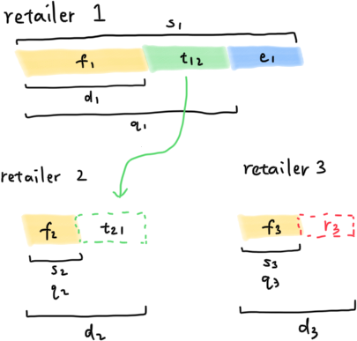
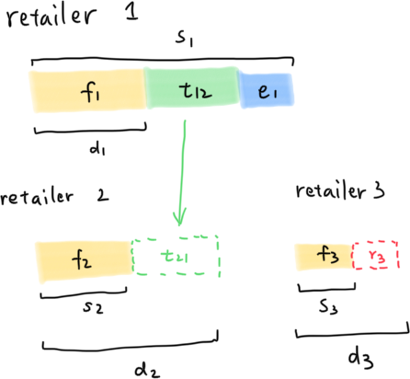
Example Graph
A Simple Example

Slide 5
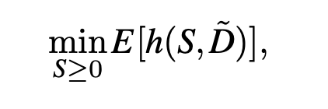
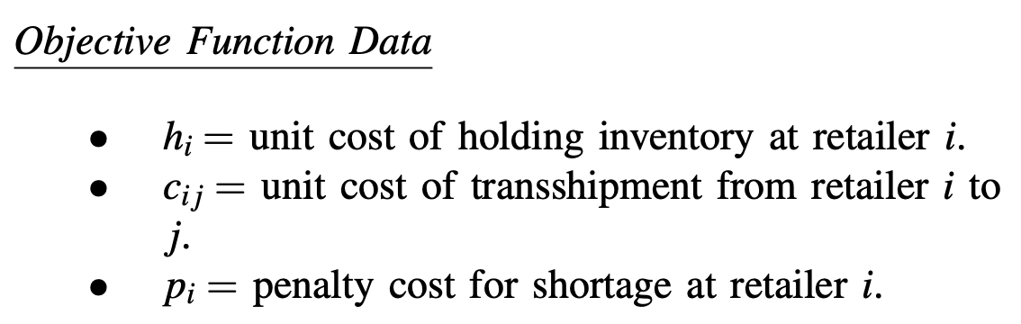
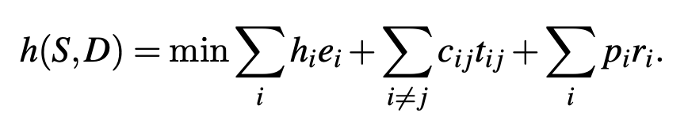
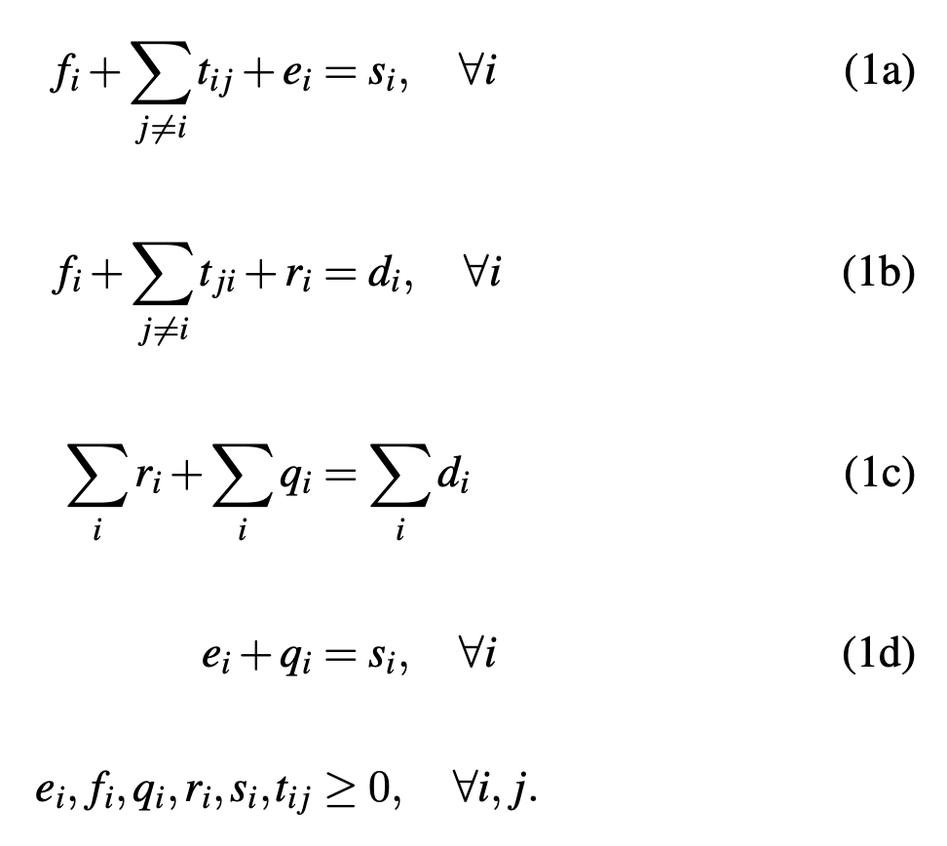
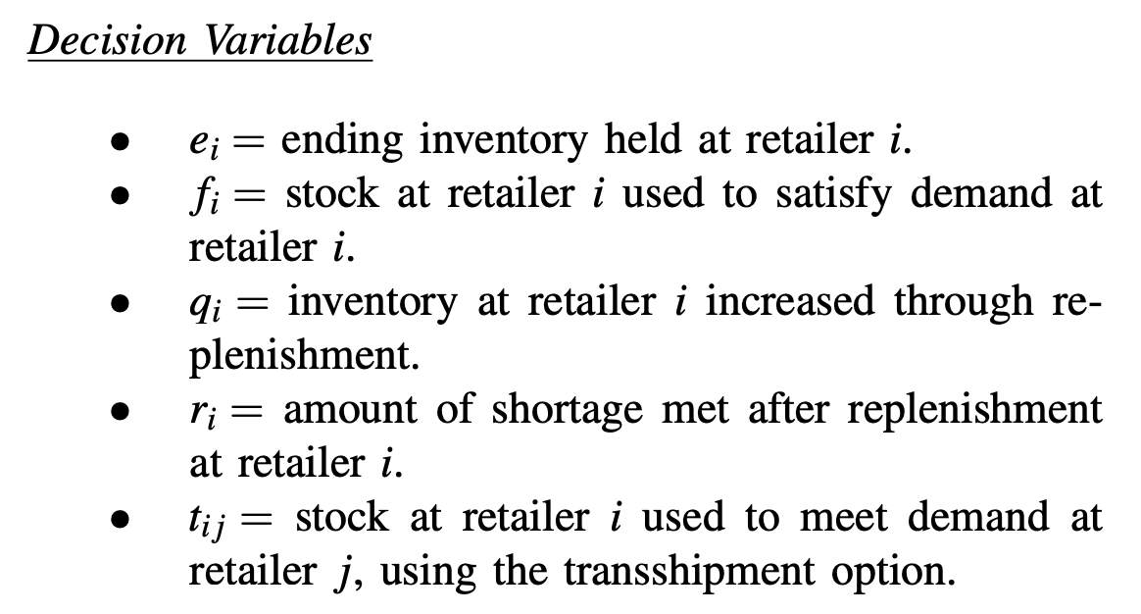
Variables and Constraints

Slide 6
Compare Two Methods
SQG: Stochastic Quasi-Gradient Method
RSD: Regularized Stochastic Decomposition

Slide 7
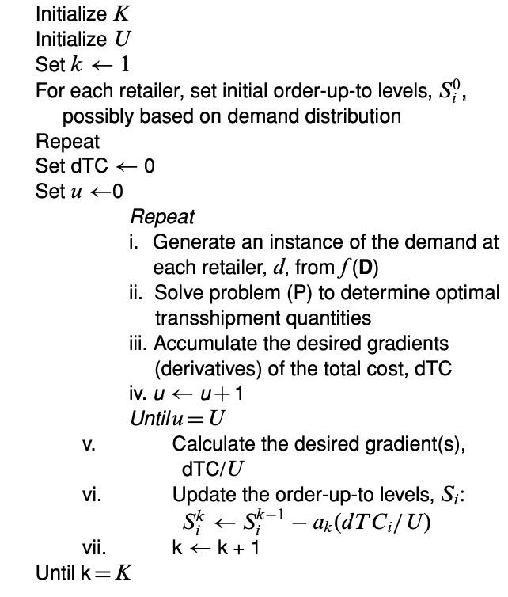
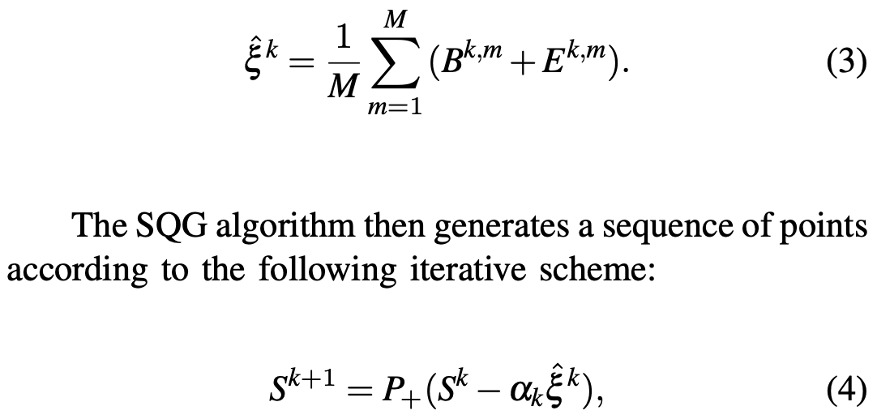
Stochastic Quasi-Gradient (SQG) Method
Pseudo-Code
From Cplex / Gurobi get dual multipliers B, E
Then get subgradient ξ as below

Slide 8
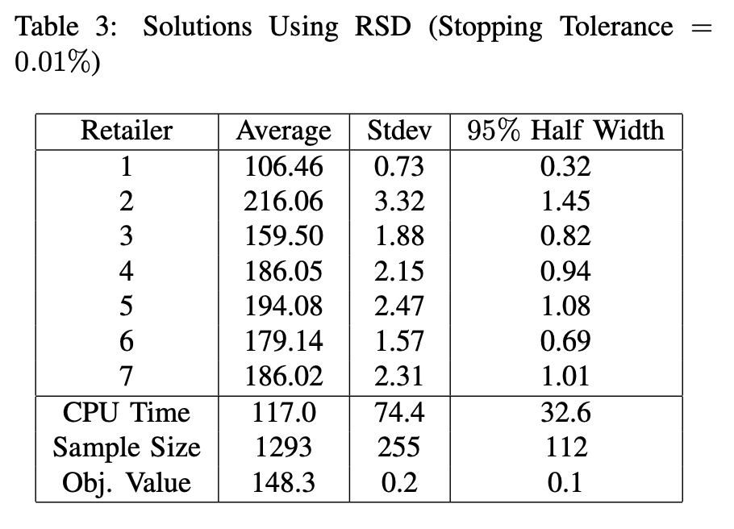
SD solver

Slide 9
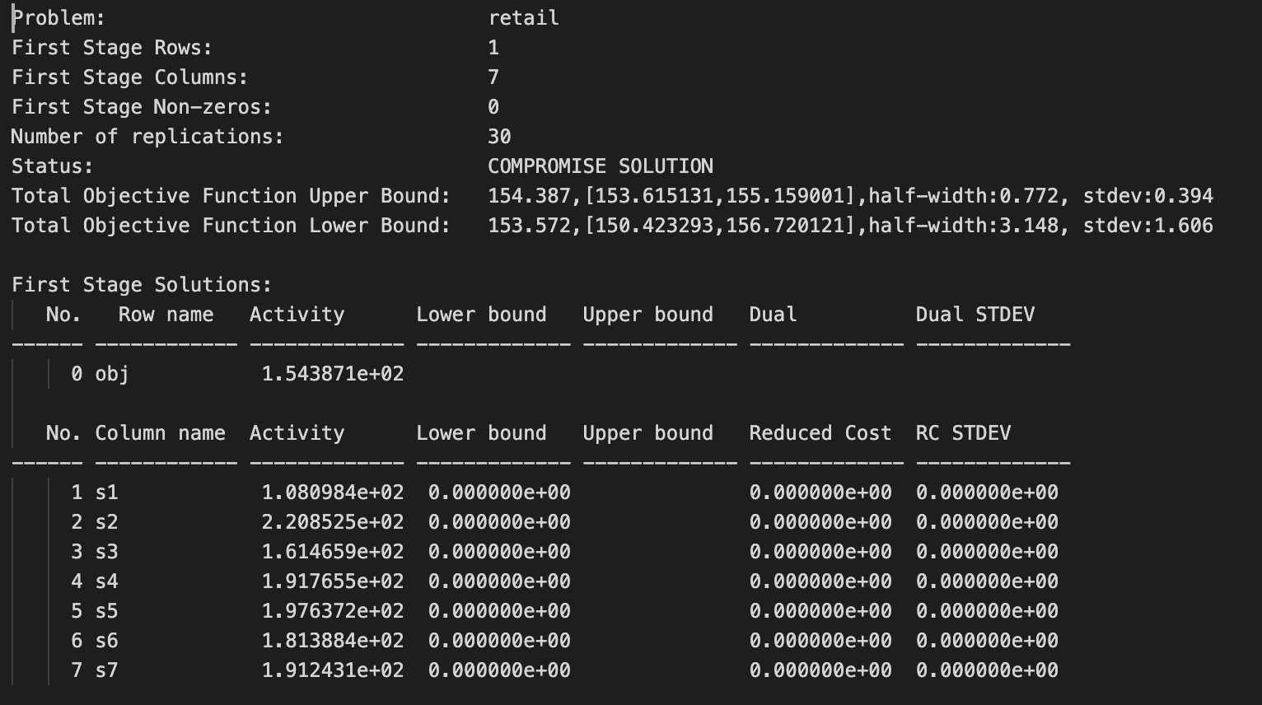

Slide 10
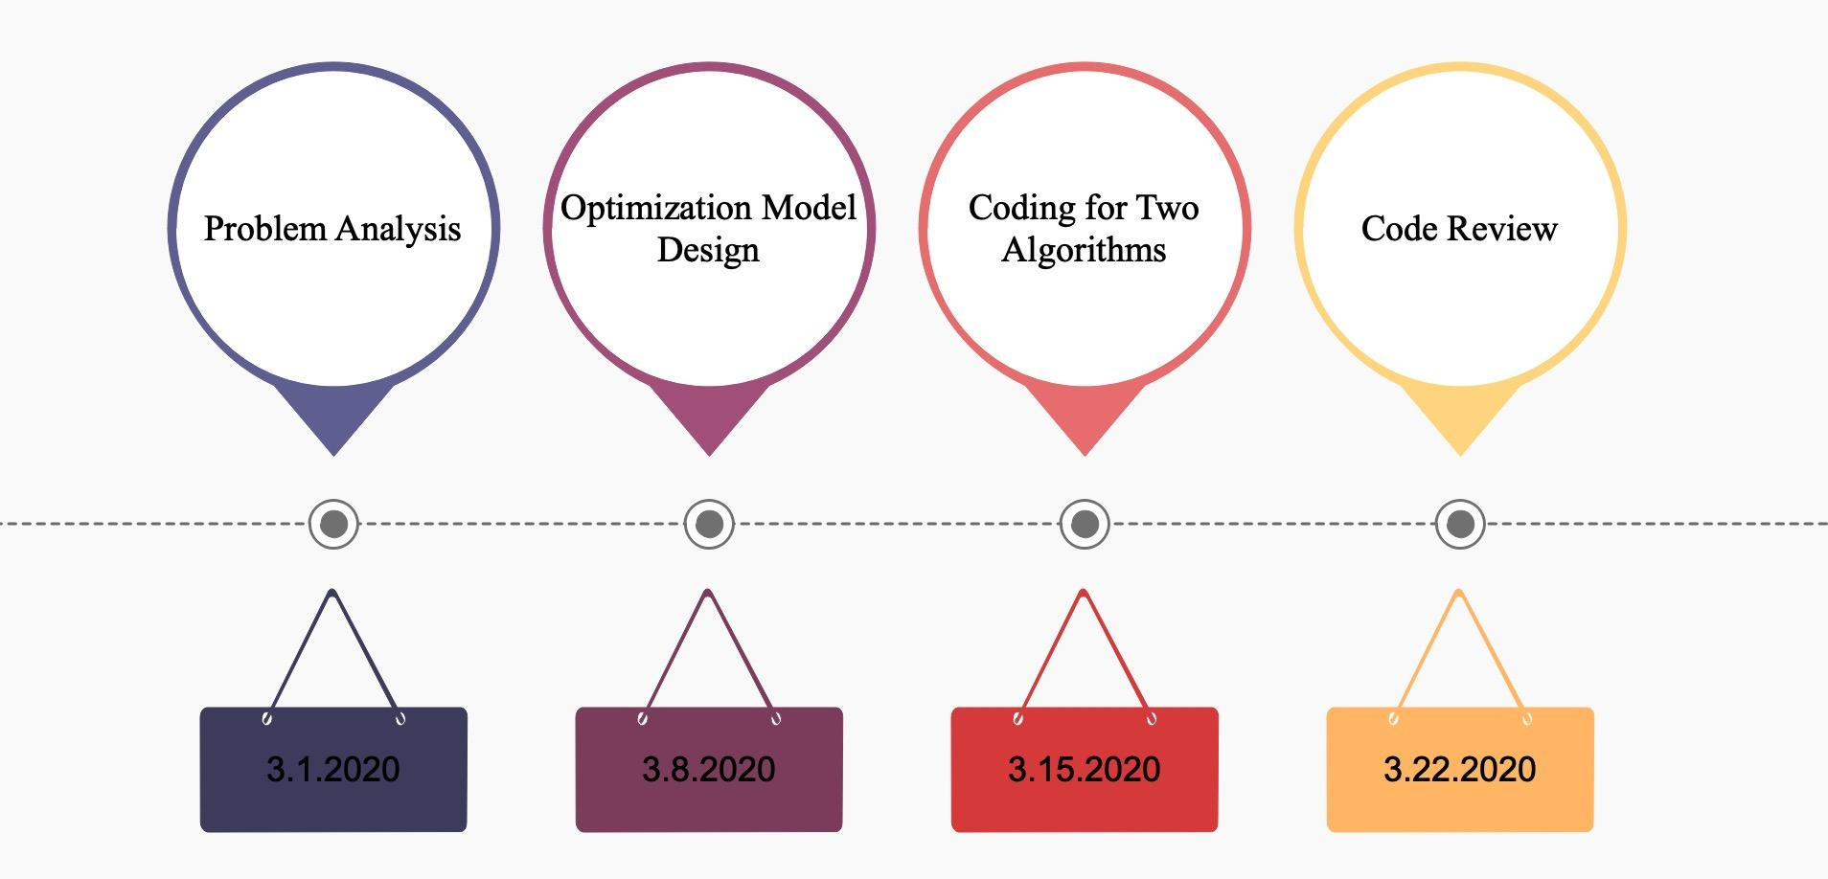
2.25.2020

Slide 11
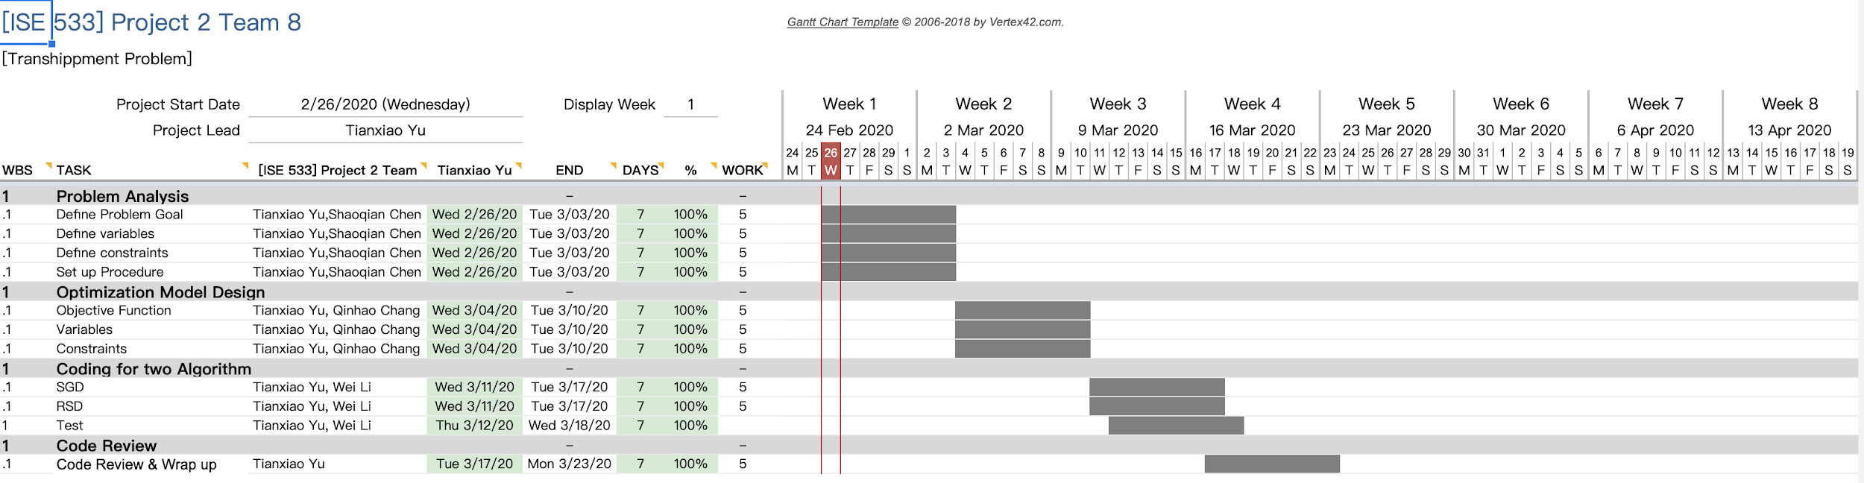
Gantt Chart

